Slide 1
Test Automation & Advanced Selenium
Lesson 1: Introduction to Automation

Slide 2
Lesson Objectives
Automation vs. Manual
What is Automation
What is Test Automation
Why And When
Example Of Test Automation

Slide 3
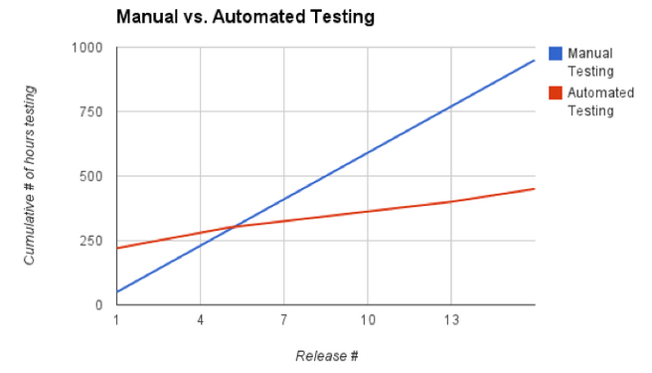
1.1: Introduction to Automation Automation vs. Manual
MANUAL TESTING
Testing is time consuming and tedious
Delay the ability in thoroughly testing an application
Critical bugs escape undetected
What happens when multiple platforms involved
AUTOMATED TESTING
Higher efficiency
Higher product quality
Easy to focus on all possible workflows
Delivers: Reusability, Consistency and Productivity

Slide 4
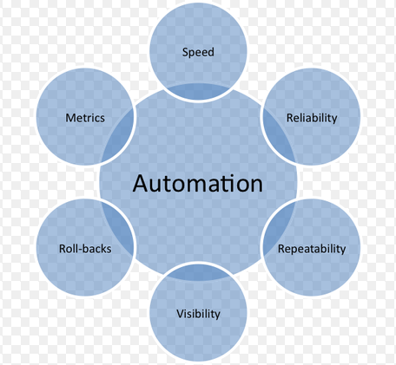
1.1: Introduction To Automation What is Automation
“The first rule of any technology used in a business is that automation applied to an efficient operation will magnify the efficiency. The second is automation applied to an inefficient operation will magnify the inefficiency.”
-Bill Gates
Notes:
Automation is the linking of disparate systems and software in such a way that they become self-acting or self-regulating.

Slide 5
1.1: Introduction To Automation What is Test Automation
The method which/that takes automation tool’s support to execute the test cases is known as Automation Testing.
It is a method which
uses automation tools to run tests that repeat predefined actions
matches the developed program’s probable and real results
If the project prospects and results align, your project is behaving as it should, and you are likely bug free. If the two don’t align, still, there is a problem that requires to be addressed. You’ll have to take a look at your code, alter it, and continue to run tests until the actual and expected outcomes align.
Notes:
Test Automation and its Benefits:
Why automate Testing?
In today´s fast moving world, it is a challenge for any company to continuously maintain and improve the quality and efficiency of software systems development. In many software projects, testing is neglected because of time or cost constraints. This leads to a lack of product quality, followed by customer dissatisfaction and ultimately to increased overall quality costs.
The main reasons for these added costs are primarily:
1.poor test strategy
2.underestimated effort of test case generation
3.delay in testing
4.subsequent test maintenance
Test automation can improve the development process of a software product in many cases. The automation of tests is initially associated with increased effort, but the related benefits will quickly pay off.
Automated tests can run fast and frequently, which is cost-effective for software products with a long maintenance life. When testing in an agile environment, the ability to quickly react to ever-changing software systems and requirements is necessary. New test cases are generated continuously and can be added to existing automation in parallel to the development of the software itself.
In both manual and automated testing environments test cases need to be modified for extended periods of time as the software project progresses. It is important to be aware that complete coverage of all tests using test automation is unrealistic. When deciding what tests to automate first, their value vs. the effort to create them needs to be considered. Test cases with high value and low effort should be automated first. Subsequently test cases with frequent use, changes, and past errors; as well as test cases with low to moderate effort in setting up the test environment and developing the automation project are best suited for automation.

Slide 6
Notes:
Optimization of Speed, Efficiency, Quality and the Decrease of Costs:
The main goal in software development processes is a timely release. Automated tests run fast and frequently, due to reused modules within different tests. Automated regression tests which ensure the continuous system stability and functionality after changes to the software were made lead to shorter development cycles combined with better quality software and thus the benefits of automated testing quickly outgain the initial costs.
Advance a Tester´s Motivation and Efficiency:
Manual testing can be mundane, error-prone and therefore become exasperating. Test automation alleviates testers' frustrations and allows the test execution without user interaction while guaranteeing repeatability and accuracy. Instead testers can now concentrate on more difficult test scenarios.
Increase of Test Coverage:
Sufficient test coverage of software projects is often achieved only with great effort. Frequent repetition of the same or similar test cases is laborious and time consuming to perform manually.
Some examples are:
Regression test after debugging or further development of software
Testing of software on different platforms or with different configurations
Data-driven testing (creation of tests using the same actions but with many different inputs)
Test automation allows performing different types of testing efficiently and effectively.

Slide 7
1.1: Introduction To Automation Why & When
Tests can run fast and frequently
Cost-effective for software products with a long maintenance life
Useful in agile environment
Robust Test Automation Projects balanced for Value and Effort
Optimization of Efficiency & Quality
Quick Return on investment (ROI) of Test Automation
Advance a Tester´s Motivation and Efficiency
More efficient Assignments of QA Tasks
Increase of Test Coverage
Different types of testing to increase test coverage
Notes:
Add the notes here.

Slide 8
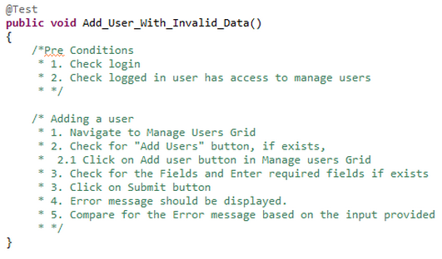
1.1: Introduction To Automation Example of Test Automation
Test Sample for Invalid Data:
Notes:
In Above example “Add Users With Valid Data”
To execute the test case, we need to login to the application. We also need to check if the user is already logged in or not. And the other we need to check is if the logged in person is having access to “Add Users” or Not. If the above Two Conditions are passed then we should execute the rest Else we should return the test as failed.

Slide 9
Summary
In this lesson, you have learnt
Testing is an extremely creative & intellectually challenging task
Manual testing is performed by a human sitting in front of a computer carefully executing the test steps
Automation Testing means using an automation tool to execute your test case suite
Goal of Automation is to reduce number of test cases to be run manually and not eliminate manual testing all together.
Notes:
Add the notes here.

Slide 10
Review Question
Question 1
Why would you want to automate a test? Is it to:
Increase test coverage?
Improve quality?
Save time for exploratory testing?
Find more bugs?
Replace manual testers?
Question 2: True/False
Automation Testing uses automation tools to run tests that repeat predefined actions.
Question 3: Fill in the Blanks
Automation Testing delivers ________, consistency and productivity.

